Slide 1
Pamplin Advancement
Program in Real estate
Industry Advisory Board Meeting
April 15, 2019

Slide 2
Pamplin Engagement Summit: Building Community The Case for Business Education in the new Knowledge Economy

Slide 3
Pamplin Engagement Summit: Who’s IN
Program in Real Estate Industry Advisory Board &
Dean’s Pamplin Advisory Council **Recent Alumni Board** **Pamplin Society**
Apex Center for Innovation and Entrepreneurship Advisory Board
Department of Finance Advisory Board
Accounting and Information Systems Department Advisory Board (ACIS) individual attendees
ACIS Emerging Leaders Board individual attendees
Marketing Industry Mentoring Board
Management Department Advisory Board
Management Department Recent Alumni Board
Hospitality Tourism and Management Advisory Board
Business Information Technology Department Advisory Board (BIT)
BIT Emerging Leaders Board MBAA Advisory Board
Sales Advisory Board

Slide 4
Pamplin Engagement Summit Offers
Unprecedented networking opportunities with Pamplin volunteer leaders from across all business disciplines
A strategic overview of the state of Pamplin Engagement 2019
Engagement: Experiential, Volunteer, Philanthropy
Stakeholders: Alumni, Corporate Employers and Friends
An opportunity to shape Pamplin’s future through strategic engagement
An insiders perspective on the Case for Business Education within the greater university, the Commonwealth of VA, and our national and global presence
First “look” at Pamplin’s new five year strategic plan
A community experience that is once in a generation for the lifecycle of the University

Slide 5
We invite you to claim your role and
PLACE

Slide 6
Program in Real Estate: Philanthropy Overview Since Inception: 21 Endowed Funds established
ENDOWED
Total Cash and Commitments $4,505,383.01
Pledge Balance $ 399,726.62
Outstanding Matching Gifts $ 32,500.00
CURRENT USE
Total Cash and Commitments $ 308,062.55
Pledge Balance (operating) $ 6,500.00
TOTAL COMMITTED $ 4,818,445.56

Slide 7
GBAC Global Business and Analytics Complex
New Learning EXPERIENCE & Environment in the new knowledge economy

Slide 8
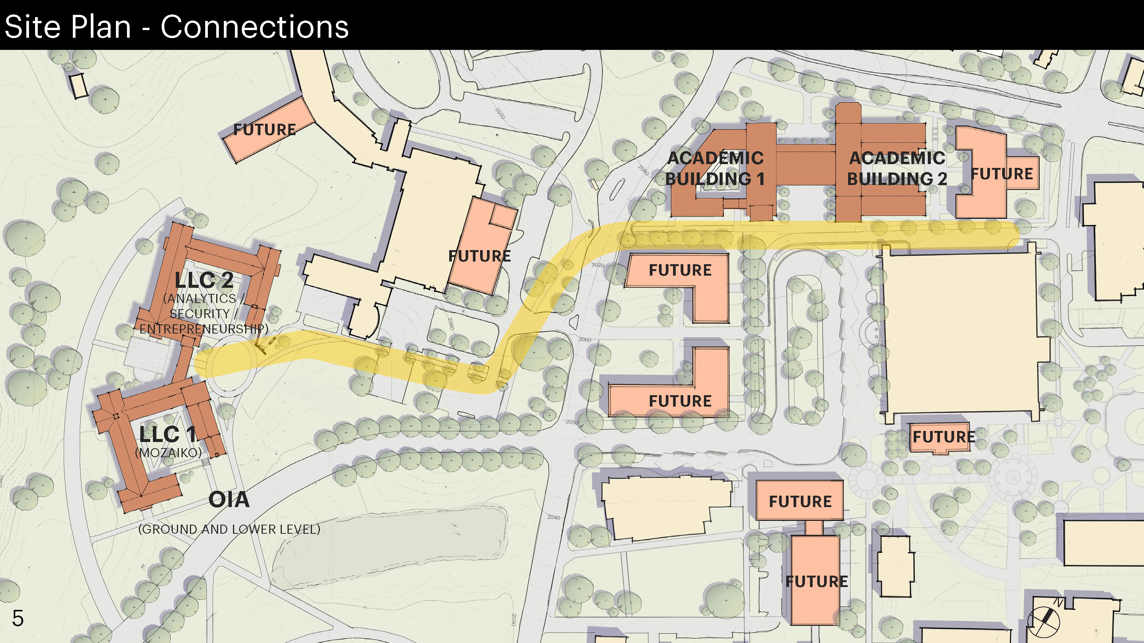
Notes:
Academic Building 1 will be Pamplin College of Business’ new building and it will include the HTM Department and HOKIE Lab and Café. This building is being funded through philanthropy.
Academic Building 2 is a Data and Decision Sciences Building housing data scientists from College of Science and College of Engineering. This is a proposed state funded facility.
Living and Learning Communities 1 and 2 are being financed through bonds and for certain enhancements, potential for private philanthropy.
Yellow route reflects an underground tunnel.

Slide 9
Testimonials
Deloitte
https://www.amazon.com/clouddrive/share/uG8NVIEVxkeXO8MAfON9bzDGxrhKAl6QEBL8yTcJ0G3/folder/MIByHfVKTcWR9g1tn7fRmg/ymPeAlEaSH2Cn4vYCAlVnw?_encoding=UTF8&*Version*=1&*entries*=0&mgh=1

Slide 10
$5,000,000 Gift Table
Gift Level | # Donors | Total | # Prospects Needed | Donors Secured | Donors Identified
$5,000,000 | 4 | $20,000,000 | 12 |  | 4
$2,500,000 | 8 | $20,000,000 | 24 | 1 | 3
$1,000,000 | 16 | $16,000,000 | 48 | 6 | 21
$500,000 | 20 | $10,000,000 | 60 | 3 | 4
$250,000 | 24 | $6,000,000 | 72 | 5 | 7
$100,000 | 30 | $3,000,000 | 90 | 4 | 45
 | 102 | $75,000,000 | 306 | 19 | 84

Slide 11
$10,000,000 Gift Table
Gift Level | # Donors | Total | # Prospects Needed | Donors Secured | Donors Identified
$10,000,000 | 1 | $10,000,000 | 3 |  | 1
$5,000,000 | 2 | $10,000,000 | 6 |  | 4
$2,500,000 | 6 | $15,000,000 | 18 | 1 | 3
$ 1,000,000 | 15 | $15,000,000 | 45 | 6 | 21
$500,000 | 25 | $12,500,000 | 75 | 3 | 4
$250,000 | 30 | $7,500,000 | 90 | 5 | 7
$100,000 | 50 | $5,000,000 | 150 | 4 | 45
 | 129 | $75,000,000 | 387 | 19 | 84

Slide 12
Pamplin Advancement Campaign Co-Chairs Volunteer Leadership
Mike Clarke
Bridget Ryan Berman
Jake Lutz
Pamplin liaisons to University Campaign Committee:
Floyd Merryman
Lynne Doughtie

Slide 13
Advancement and the Program in Real Estate
Advancement is centralized and has embedded Advancement teams in the colleges.
Multiple officers work with individual donors: regional model.
Pamplin Advancement are the liaisons to University Advancement. We conduct trainings, Information conduits and serve as relationship managers.
What’s ahead FY 2020: Campaign launch and Pamplin Engagement Summit and multiple follow on regional events
Finalization of Engagement study to inform decisions in support of the Pamplin Strategic Plan
Pamplin Case Statement includes Program in Real Estate

Slide 14
Robert Sumichrast
Dean, Pamplin College of Business
Michael Moyer
Associate VP of Development for Colleges
Elizabeth Mitchell
Assistant Dean of Advancement
Tracy Vosburgh
Senior Associate VP for University Relations
Matt Winston
Senior Associate VP for Alumni Relations
Parviz Ghandforoush
Associate Dean, Graduate Programs
Mark Owczarski
Assistant VP for University Relations
Development Associate Kelly Ratcliffe
Debbie Day
Associate VP for Alumni Relations
Associate Director, Career Services and Alumni Relations
Emily Pinette
Director of Communications and Marketing
New Line FY 19
Director of Development
Marise Robbins-Forbes
Director of Engagement Crystal Jefferson
as of 1-10-17
Associate Director
Marketing, Graduate Programs
Julia Falkenstern
Web Content Writer
Jeremy Norman
Director of Communications Sookhan Ho
Assistant Director of Development
for Leadership Gifts
Sarah White
Associate Director of Development Chris Bartlett
Associate Director of Development
Gene Bourne
Associate Director of Development
Gretchen Tucker
Development Associate Jodi Jennings
Director of Alumni Relations Bonnie Gilbert
Assistant Director Special Events
Amy Weishaar
Gray box = college positions

Slide 15
Pamplin Events
4/24/19: Students of Distinction Reception: Blacksburg
4/26-19-4/27/19: Ut Prosim Weekend: Blacksburg
5/2/19: All Alumni and Friends Reception, Cybersecurity Panel & celebrating 50 years in Northern VA
5/17/19: Commencement: Blacksburg
6/6/19-6/9/19: VT Alumni Reunion Weekend Classes ending 4’s and 9’s: Blacksburg
6/13/19: Pamplin Society Thought Leadership Seminar- Freddie Mac
9/7/19 Pamplin Homecoming Tailgate: Blacksburg
10/10-10/11 Pamplin Engagement Summit: Roanoke
10/10-10/12 Campaign Launch (Tailgate and game)- Blacksburg

